Slide 1
Financial AI – Week 7 Problem 3
Object Oriented Programming
October 02th, 2022
이후범, 정효찬, 황정민

Slide 2

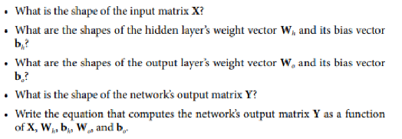
Problem 3 - 1

Slide 3
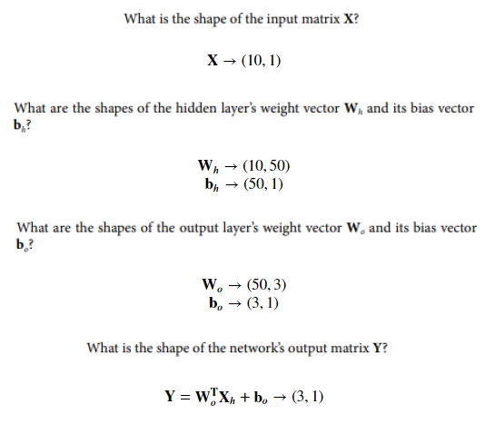
Problem 3 - 1

Slide 4
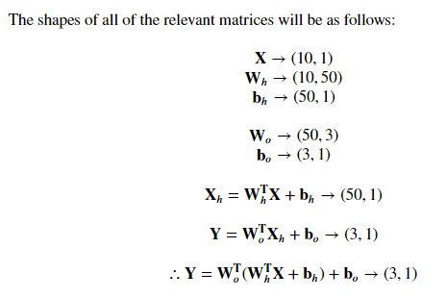
Problem 3 - 1

Slide 5
Problem 3 - 2
Backpropagation is used for training NN model.
It computes the gradient of cost function every model parameters(ie. all weights and biases) then it performs a Gradient Descent using these gradients.
W+ = W - dE/DW, b+ = b-dE/db (E is cost function)
Reverse-mode autodiff performs a forward pass through a computation graph, computing every node’s value for the current training batch, and then it performs a reverse pass, computing all the gradients at once.
Using Reverse-mode autodiff we can calculate the gradients efficiently.
To sum up, Backpropagation is process of updating the parameters used in NN model and reverse-mode autodiff is one of ways to calculate gradients to be used for backpropagation.

Slide 6
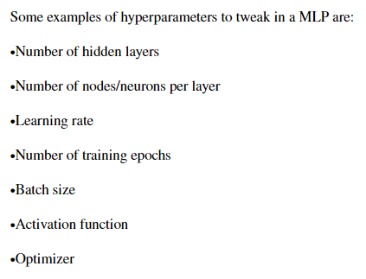
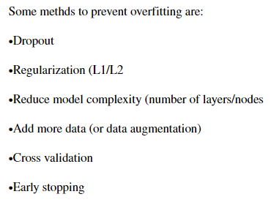
Problem 3 - 3

Slide 7
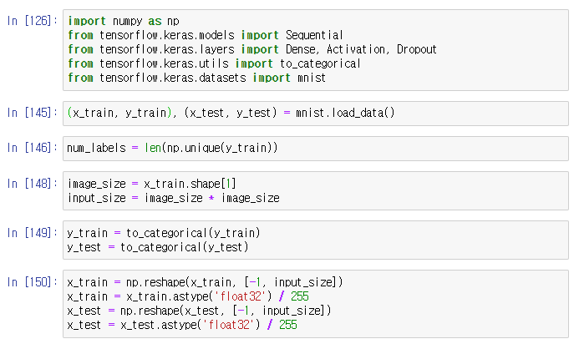
Problem 3 - 3

Slide 8
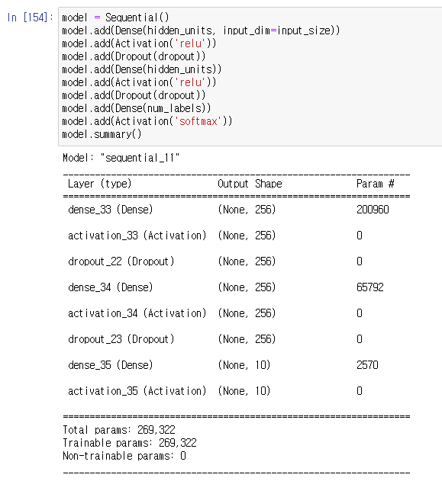
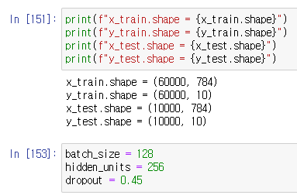
Problem 3 - 3

Slide 9
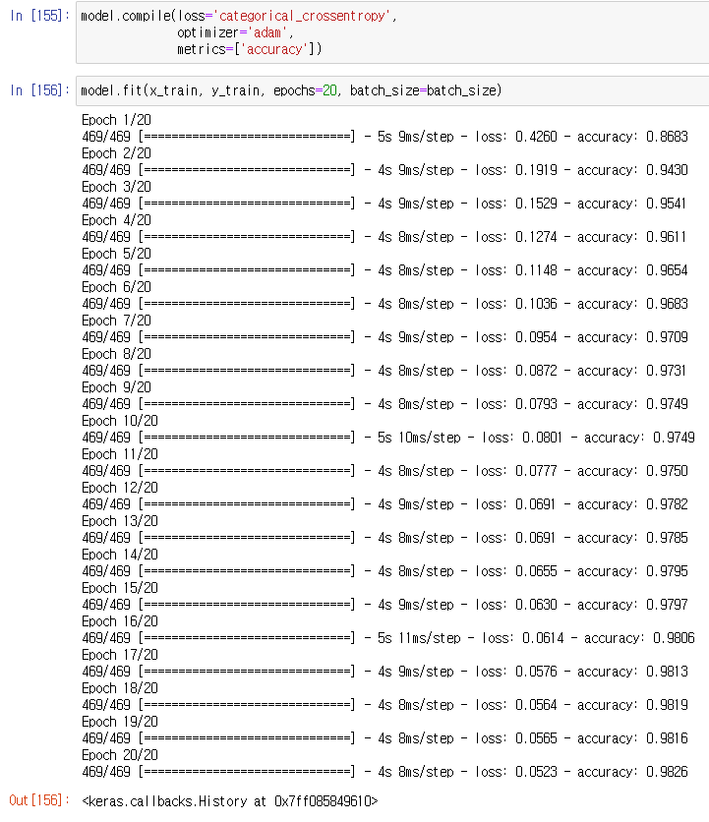
Problem 3 - 3

Slide 10

Problem 3 - 3

